Slide 1
Object-Oriented and
Classical Software Engineering
8th Edition, WCB/McGraw-Hill, 2010
Stephen R. Schach srs@vuse.vanderbilt.edu

Slide 2
CHAPTER 14
IMPLEMENTATION

Slide 3
Overview
Choice of programming language
Fourth generation languages
Good programming practice
Coding standards
Code reuse
Integration
The implementation workflow
The implementation workflow: The MSG Foundation case study
The test workflow: Implementation

Slide 4
Overview (contd)
Test case selection
Black-box unit-testing techniques
Black-box test cases: The MSG Foundation case study
Glass-box unit-testing technique
Code walkthroughs and inspections
Comparison of unit-testing techniques
Cleanroom
Potential problems when testing objects
Management aspects of unit testing

Slide 5
Overview (contd)
When to rewrite rather than debug a module
Integration testing
Product testing
Acceptance testing
The test workflow: The MSG Foundation case study
CASE tools for implementation
Metrics for the implementation workflow
Challenges of the implementation workflow

Slide 6
Implementation
Real-life products are generally too large to be implemented by a single programmer
This chapter therefore deals with programming-in-the-many

Slide 7
14.1 Choice of Programming Language (contd)
The language is usually specified in the contract
But what if the contract specifies that
  The product is to be implemented in the “most suitable” programming language
What language should be chosen?

Slide 8
Choice of Programming Language (contd)
Example
  QQQ Corporation has been writing COBOL programs for over 25 years
  Over 200 software staff, all with COBOL expertise
  What is “the most suitable” programming language?
Obviously COBOL

Slide 9
Choice of Programming Language (contd)
What happens when new language (C++, say) is introduced
  C++ professionals must be hired
  Existing COBOL professionals must be retrained
  Future products are written in C++
  Existing COBOL products must be maintained
  There are two classes of programmers
    COBOL maintainers (despised)
    C++ developers (paid more)
  Expensive software, and the hardware to run it, are needed
  100s of person-years of expertise with COBOL are wasted

Slide 10
Choice of Programming Language (contd)
The only possible conclusion
  COBOL is the “most suitable” programming language
And yet, the “most suitable” language for the latest project may be C++
  COBOL is suitable for only data processing applications
How to choose a programming language
  Cost–benefit analysis
  Compute costs and benefits of all relevant languages

Slide 11
Choice of Programming Language (contd)
Which is the most appropriate object-oriented language?
  C++ is (unfortunately) C-like
  Thus, every classical C program is automatically a C++ program
  Java enforces the object-oriented paradigm
  Training in the object-oriented paradigm is essential before adopting any object-oriented language
What about choosing a fourth generation language (4GL)?

Slide 12
14.2 Fourth Generation Languages
First generation languages
  Machine languages
Second generation languages
  Assemblers
Third generation languages
  High-level languages (COBOL, FORTRAN, C++, Java)

Slide 13
Fourth Generation Languages (contd)
Fourth generation languages (4GLs)
  One 3GL statement is equivalent to 5–10 assembler statements
  Each 4GL statement was intended to be equivalent to 30 or even 50 assembler statements

Slide 14
Fourth Generation Languages (contd)
It was hoped that 4GLs would
  Speed up application-building
  Result in applications that are easy to build and quick to change
    Reducing maintenance costs
  Simplify debugging
  Make languages user friendly
    Leading to end-user programming
Achievable if 4GL is a user friendly, very high-level language

Slide 15
Fourth Generation Languages (contd)
Example
  See Just in Case You Wanted to Know Box 14.2
The power of a nonprocedural language, and the price

Slide 16
Productivity Increases with a 4GL?
The picture is not uniformly rosy
Playtex used ADF, obtained an 80 to 1 productivity increase over COBOL
  However, Playtex then used COBOL for later applications
4GL productivity increases of 10 to 1 over COBOL have been reported
  However, there are plenty of reports of bad experiences

Slide 17
Actual Experiences with 4GLs
Many 4GLs are supported by powerful CASE environments
  This is a problem for organizations at CMM level 1 or 2
  Some reported 4GL failures are due to the underlying CASE environment

Slide 18
Actual Experiences with 4GLs (contd)
Attitudes of 43 organizations to 4GLs
  Use of 4GL reduced users’ frustrations
  Quicker response from DP department
  4GLs are slow and inefficient, on average
  Overall, 28 organizations using 4GL for over 3 years felt that the benefits outweighed the costs

Slide 19
Fourth Generation Languages (contd)
Market share
  No one 4GL dominates the software market
  There are literally hundreds of 4GLs
  Dozens with sizable user groups
  Oracle, DB2, and PowerBuilder are extremely popular
Reason
  No one 4GL has all the necessary features
Conclusion
  Care has to be taken in selecting the appropriate 4GL

Slide 20
Dangers of a 4GL
End-user programming
  Programmers are taught to mistrust computer output
  End users are taught to believe computer output
  An end-user updating a database can be particularly dangerous

Slide 21
Dangers of a 4GL (contd)
Potential pitfalls for management
  Premature introduction of a CASE environment
  Providing insufficient training for the development team
  Choosing the wrong 4GL

Slide 22
14.3 Good Programming Practice
Use of consistent and meaningful variable names
  “Meaningful” to future maintenance programmers
  “Consistent” to aid future maintenance programmers

Slide 23
14.3.1 Use of Consistent and Meaningful Variable Names
A code artifact includes the variable names freqAverage, frequencyMaximum, minFr, frqncyTotl
A maintenance programmer has to know if freq, frequency, fr, frqncy all refer to the same thing
  If so, use the identical word, preferably frequency, perhaps freq or frqncy, but not fr
  If not, use a different word (e.g., rate) for a different quantity

Slide 24
Consistent and Meaningful Variable Names
We can use frequencyAverage, frequencyMaximum, frequencyMinimum, frequencyTotal
We can also use averageFrequency, maximumFrequency, minimumFrequency, totalFrequency
But all four names must come from the same set

Slide 25
14.3.2 The Issue of Self-Documenting Code
Self-documenting code is exceedingly rare
The key issue: Can the code artifact be understood easily and unambiguously by
  The SQA team
  Maintenance programmers
  All others who have to read the code

Slide 26
Self-Documenting Code Example
Example:
  Code artifact contains the variable xCoordinateOfPositionOfRobotArm
  This is abbreviated to xCoord
  This is fine, because the entire module deals with the movement of the robot arm
  But does the maintenance programmer know this?

Slide 27
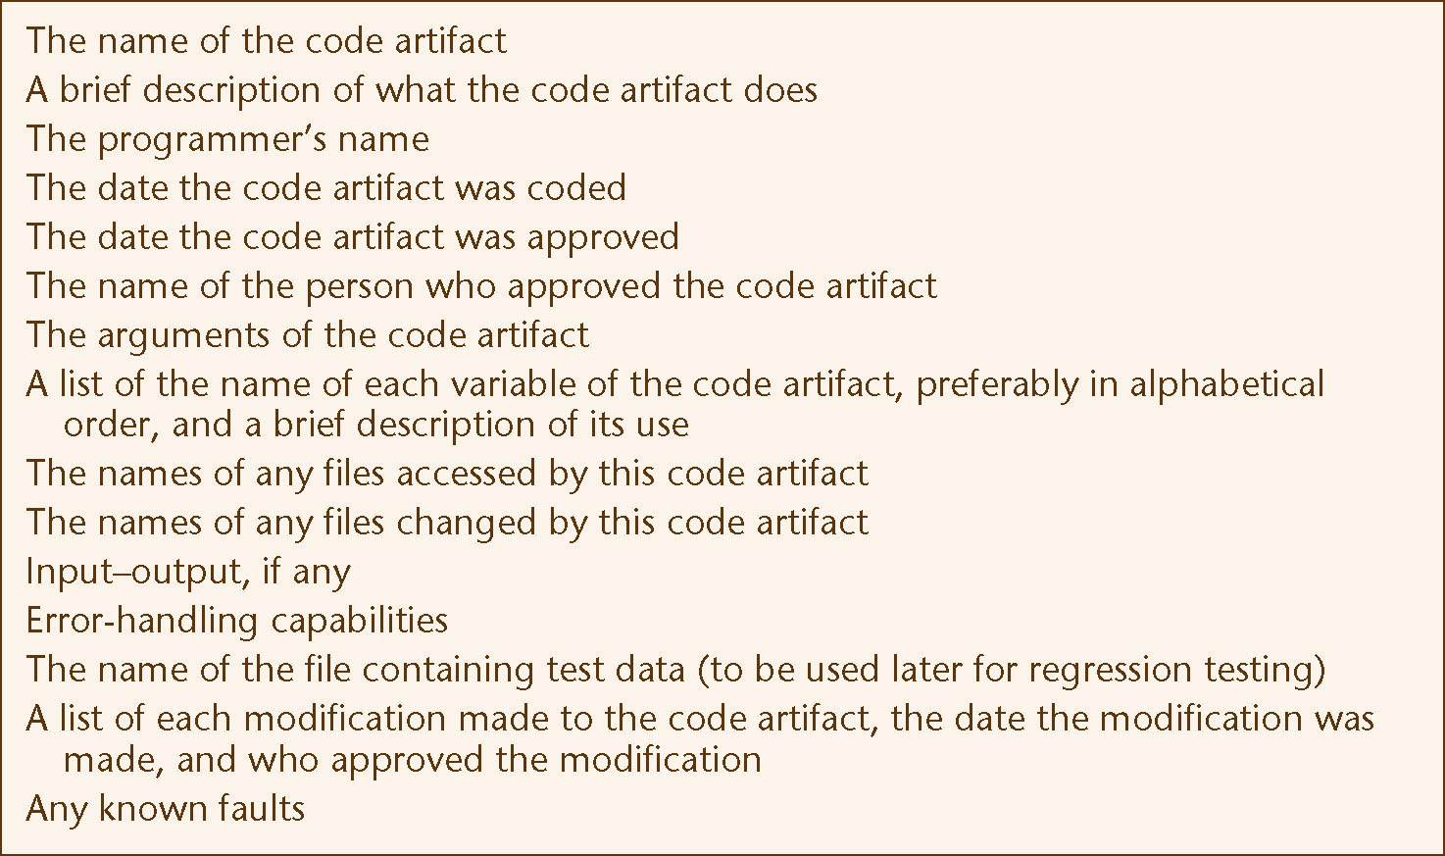
Prologue Comments
Minimal prologue comments for a code artifact
Figure 14.2

Slide 28
Other Comments
Suggestion
  Comments are essential whenever the code is written in a non-obvious way, or makes use of some subtle aspect of the language
Nonsense!
  Recode in a clearer way
  We must never promote/excuse poor programming
  However, comments can assist future maintenance programmers

Slide 29
14.3.3 Use of Parameters
There are almost no genuine constants
One solution:
  Use const statements (C++), or
  Use public static final statements (Java)
A better solution:
  Read the values of “constants” from a parameter file

Slide 30
14.3.4 Code Layout for Increased Readability
Use indentation
Better, use a pretty-printer
Use plenty of blank lines
  To break up big blocks of code

Slide 31
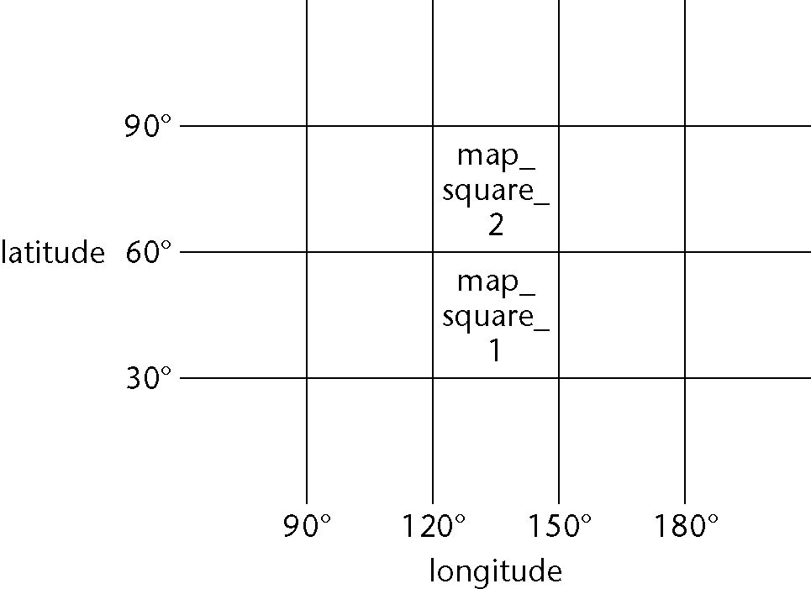
14.3.5 Nested if Statements
Example
  A map consists of two squares. Write code to determine whether a point on the Earth’s surface lies in map_square_1 or map_square_2, or is not on the map
Figure 14.2

Slide 32
Nested if Statements (contd)
Solution 1. Badly formatted
Figure 14.3

Slide 33
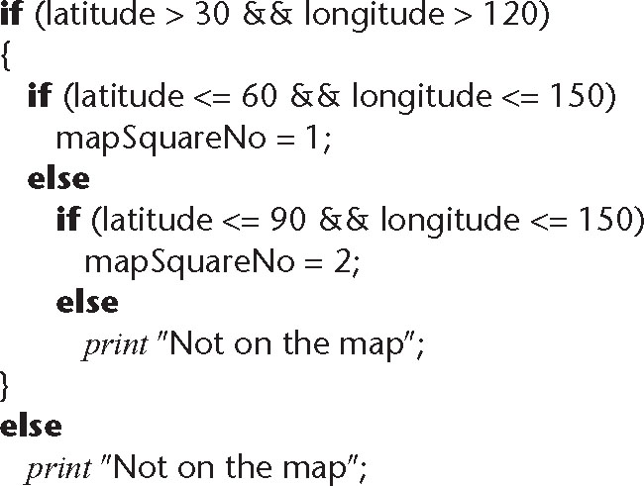
Nested if Statements (contd)
Solution 2. Well-formatted, badly constructed
Figure 14.4

Slide 34
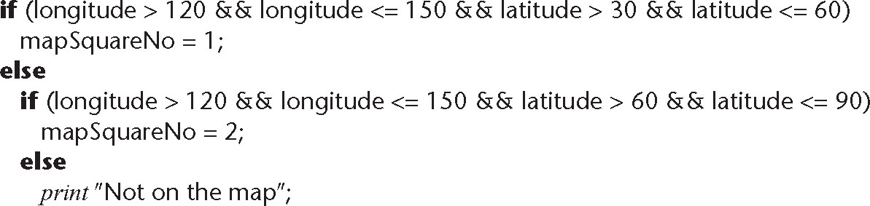
Nested if Statements (contd)
Solution 3. Acceptably nested
Figure 14.5

Slide 35
Nested if Statements (contd)
A combination of if-if and if-else-if statements is usually difficult to read
Simplify: The if-if combination
  if <condition1>
  if <condition2>
is frequently equivalent to the single condition
  if <condition1> && <condition2>

Slide 36
Nested if Statements (contd)
Rule of thumb
  if statements nested to a depth of greater than three should be avoided as poor programming practice

Slide 37
14.4 Programming Standards
Standards can be both a blessing and a curse
Modules of coincidental cohesion arise from rules like
  “Every module will consist of between 35 and 50 executable statements”
Better
  “Programmers should consult their managers before constructing a module with fewer than 35 or more than 50 executable statements”

Slide 38
Remarks on Programming Standards
No standard can ever be universally applicable
Standards imposed from above will be ignored
Standard must be checkable by machine

Slide 39
Examples of Good Programming Standards
“Nesting of if statements should not exceed a depth of 3, except with prior approval from the team leader”
“Modules should consist of between 35 and 50 statements, except with prior approval from the team leader”
“Use of gotos should be avoided. However, with prior approval from the team leader, a forward goto may be used for error handling”

Slide 40
Remarks on Programming Standards (contd)
The aim of standards is to make maintenance easier
  If they make development difficult, then they must be modified
  Overly restrictive standards are counterproductive
  The quality of software suffers

Slide 41
14.5 Code Reuse
Code reuse is the most common form of reuse
However, artifacts from all workflows can be reused
  For this reason, the material on reuse appears in Chapter 8, and not here

Slide 42
14.6 Integration
The approach up to now:
  Implementation followed by integration
This is a poor approach
Better:
  Combine implementation and integration methodically

Slide 43
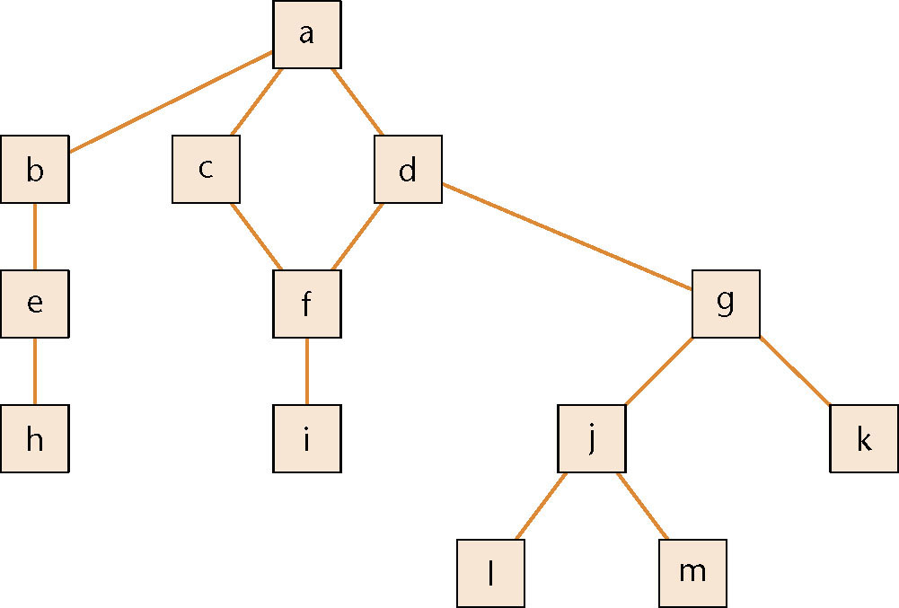
Product with 13 Modules
Figure 14.6

Slide 44
Implementation, Then Integration
Code and test each code artifact separately
Link all 13 artifacts together, test the product as a whole

Slide 45
Drivers and Stubs
To test artifact a, artifacts b,c,d must be stubs
  An empty artifact, or
  Prints a message ("Procedure radarCalc called"), or
  Returns precooked values from preplanned test cases
To test artifact h on its own requires a driver, which calls it
  Once, or
  Several times, or
  Many times, each time checking the value returned
Testing artifact d requires a driver and two stubs

Slide 46
Implementation, Then Integration (contd)
Problem 1
  Stubs and drivers must be written, then thrown away after unit testing is complete
Problem 2
  Lack of fault isolation
  A fault could lie in any of the 13 artifacts or 13 interfaces
  In a large product with, say, 103 artifacts and 108 interfaces, there are 211 places where a fault might lie

Slide 47
Implementation, Then Integration (contd)
Solution to both problems
  Combine unit and integration testing

Slide 48
14.6.1 Top-down Integration
If code artifact mAbove sends a message to artifact mBelow, then mAbove is implemented and integrated before mBelow
One possible top-down ordering is
  a,b,c,d,e,f,g,
  h,i,j,k,l,m
Figure 14.6 (again)

Slide 49
Top-down Integration (contd)
Another possible top-down ordering is
  a
  [a] b,e,h
  [a] c,d,f,i
  [a,d] g,j,k,l,m
Figure 14.6 (again)

Slide 50
Top-down Integration (contd)
Advantage 1: Fault isolation
  A previously successful test case fails when mNew is added to what has been tested so far
    The fault must lie in mNew or the interface(s) between mNew and the rest of the product
Advantage 2: Stubs are not wasted
  Each stub is expanded into the corresponding complete artifact at the appropriate step

Slide 51
Top-down Integration (contd)
Advantage 3: Major design flaws show up early
Logic artifacts include the decision-making flow of control
  In the example, artifacts a,b,c,d,g,j
Operational artifacts perform the actual operations of the product
  In the example, artifacts e,f,h,i,k,l,m
The logic artifacts are developed before the operational artifacts

Slide 52
Top-down Integration (contd)
Problem 1
  Reusable artifacts are not properly tested
  Lower level (operational) artifacts are not tested frequently
  The situation is aggravated if the product is well designed
Defensive programming (fault shielding)
  Example:
  if (x >= 0)
    y = computeSquareRoot (x, errorFlag);
  computeSquareRoot is never tested with x < 0
  This has implications for reuse

Slide 53
14.6.2 Bottom-up Integration
If code artifact mAbove calls code artifact mBelow, then mBelow is implemented and integrated before mAbove
One possible bottom-up ordering is
  l,m,h,i,j,k,e,
  f,g,b,c,d,a
Figure 14.6 (again)

Slide 54
14.6.2 Bottom-up Integration
Another possible bottom-up ordering is
h,e,b
i,f,c,d
l,m,j,k,g [d]
a [b,c,d]
Figure 14.6 (again)

Slide 55
Bottom-up Integration (contd)
Advantage 1
  Operational artifacts are thoroughly tested
Advantage 2
  Operational artifacts are tested with drivers, not by fault shielding, defensively programmed artifacts
Advantage 3
  Fault isolation

Slide 56
Bottom-up Integration (contd)
Difficulty 1
  Major design faults are detected late
Solution
  Combine top-down and bottom-up strategies making use of their strengths and minimizing their weaknesses

Slide 57
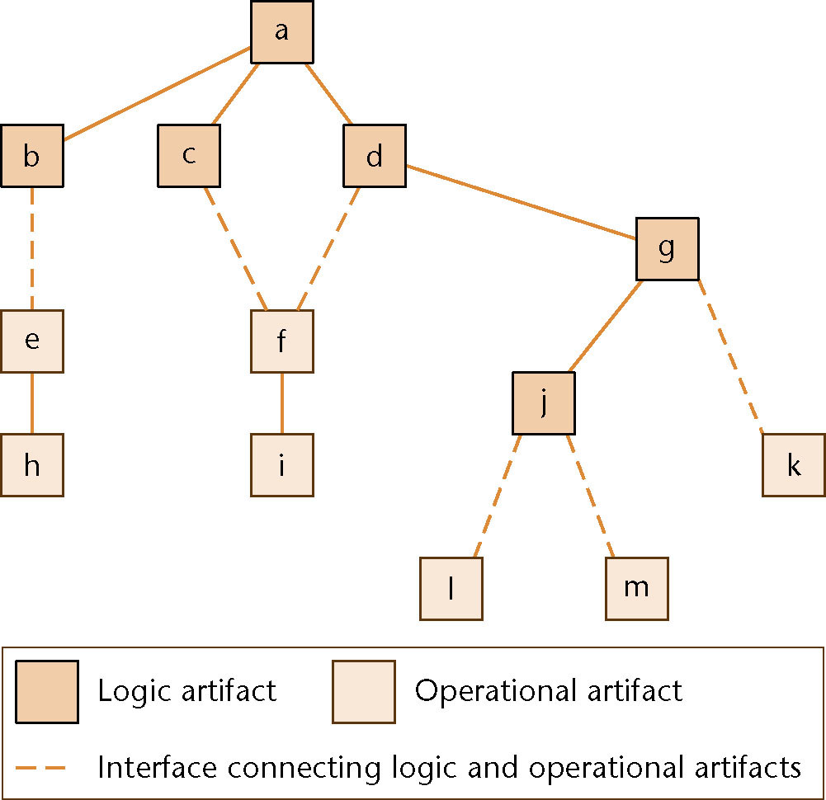
14.6.3 Sandwich Integration
Logic artifacts are integrated top-down
Operational artifacts are integrated bottom-up
Finally, the interfaces between the two groups are tested
Figure 14.7

Slide 58
Sandwich Integration (contd)
Advantage 1
  Major design faults are caught early
Advantage 2
  Operational artifacts are thoroughly tested
  They may be reused with confidence
Advantage 3
  There is fault isolation at all times

Slide 59
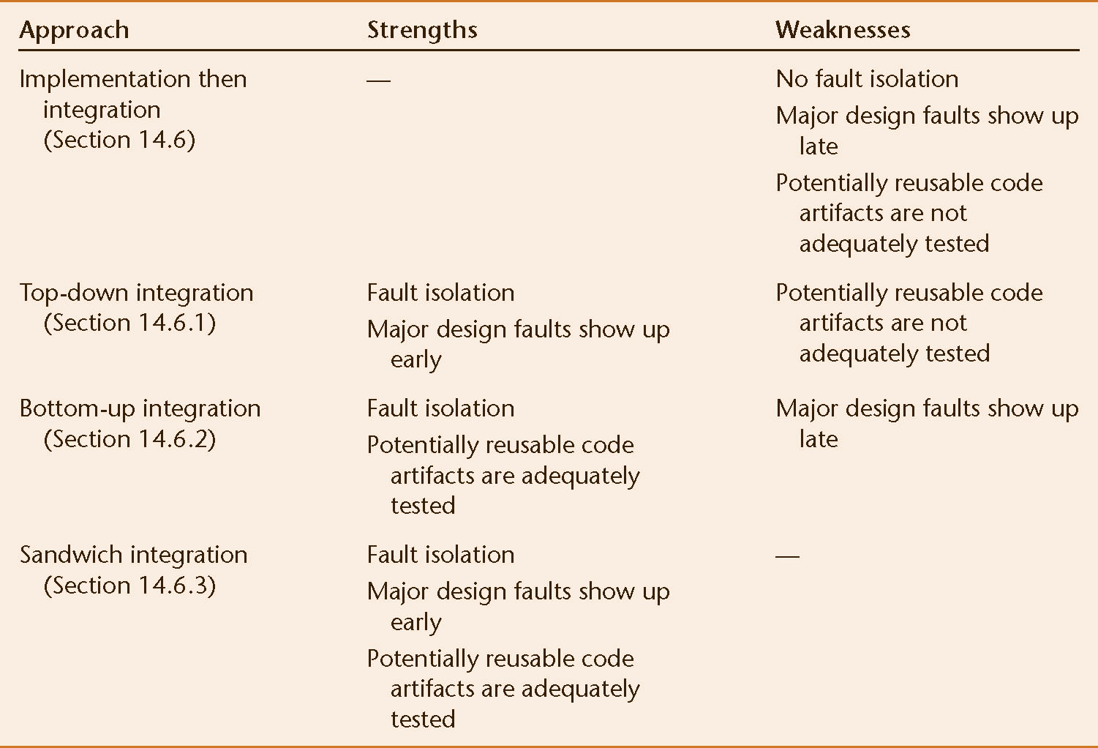
Summary
Figure 14.8

Slide 60
14.6.4 Integration of Object-Oriented Products
Object-oriented implementation and integration
  Almost always sandwich implementation and integration
  Objects are integrated bottom-up
  Other artifacts are integrated top-down

Slide 61
14.6.5 Management of Integration
Example:
  Design document used by programmer P₁ (who coded code object o1) shows o1 sends a message to o2 passing 4 arguments
  Design document used by programmer P₂ (who coded code artifact o2) states clearly that only 3 arguments are passed to o2
Solution:
  The integration process must be run by the SQA group
  They have the most to lose if something goes wrong

Slide 62
14.7 The Implementation Workflow
The aim of the implementation workflow is to implement the target software product
A large product is partitioned into subsystems
  Implemented in parallel by coding teams
Subsystems consist of components or code artifacts

Slide 63
The Implementation Workflow (contd)
Once the programmer has implemented an artifact, he or she unit tests it
Then the module is passed on to the SQA group for further testing
  This testing is part of the test workflow

Slide 64
14.8 The Implementation Workflow: The MSG Foundation Case Study
Complete implementations in Java and C++ can be downloaded from www.mhhe.com/engcs/schach

Slide 65
14.9 The Test Workflow: Implementation
Unit testing
  Informal unit testing by the programmer
  Methodical unit testing by the SQA group
There are two types of methodical unit testing
  Non-execution-based testing
  Execution-based testing

Slide 66
14.10 Test Case Selection
Worst way — random testing
  There is no time to test all but the tiniest fraction of all possible test cases, totaling perhaps 10¹⁰⁰ or more
We need a systematic way to construct test cases

Slide 67
14.10.1 Testing to Specifications versus Testing to Code
There are two extremes to testing
Test to specifications (also called black-box, data-driven, functional, or input/output driven testing)
  Ignore the code — use the specifications to select test cases
Test to code (also called glass-box, logic-driven, structured, or path-oriented testing)
  Ignore the specifications — use the code to select test cases

Slide 68
14.10.2 Feasibility of Testing to Specifications
Example:
  The specifications for a data processing product include 5 types of commission and 7 types of discount
  35 test cases
We cannot say that commission and discount are computed in two entirely separate artifacts — the structure is irrelevant

Slide 69
Feasibility of Testing to Specifications (contd)
Suppose the specifications include 20 factors, each taking on 4 values
  There are 4²⁰ or 1.1 × 10¹² test cases
  If each takes 30 seconds to run, running all test cases takes more than 1 million years
The combinatorial explosion makes testing to specifications impossible

Slide 70
14.10.3 Feasibility of Testing to Code
Each path through a artifact must be executed at least once
  Combinatorial explosion

Slide 71
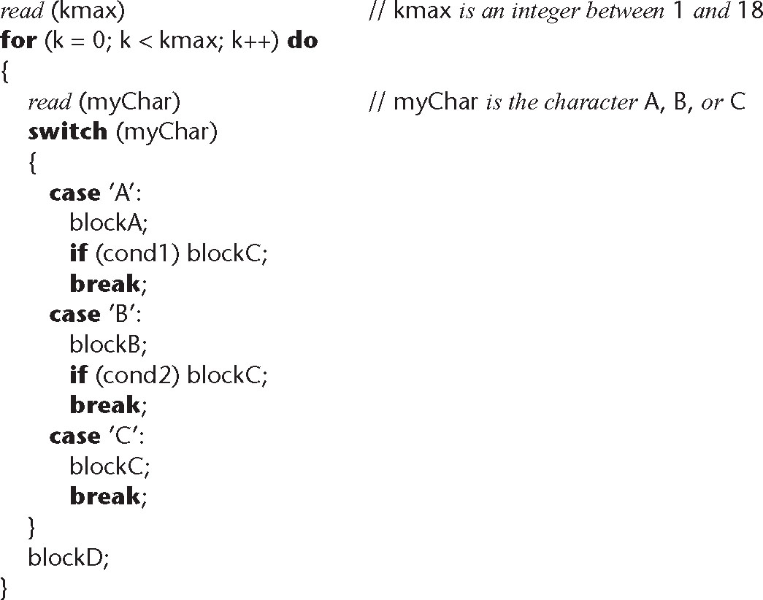
Feasibility of Testing to Code (contd)
Code example:
Figure 14.9

Slide 72
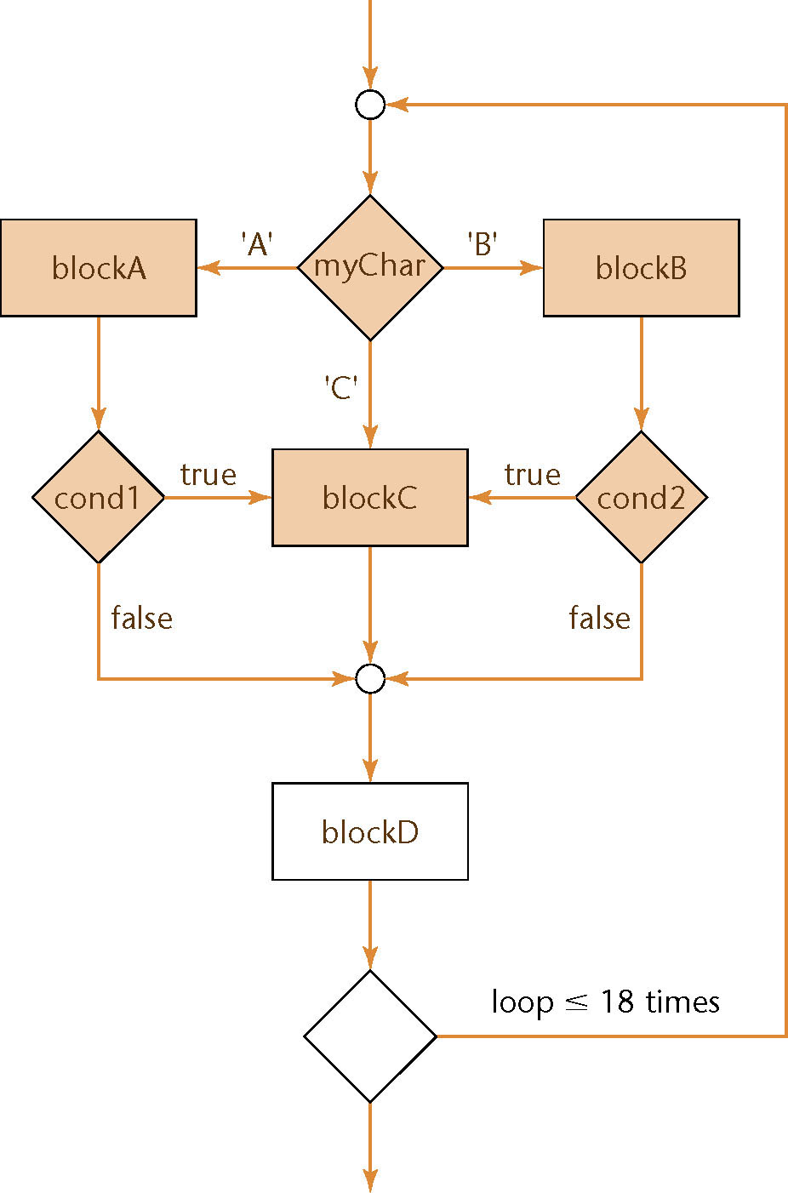
Feasibility of Testing to Code (contd)
The flowchart has over 10¹² different paths
Figure 14.10

Slide 73
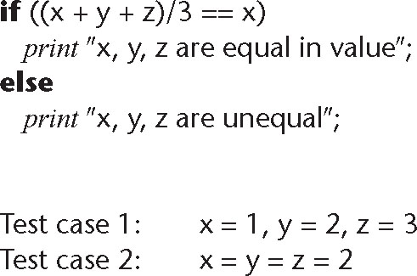
Feasibility of Testing to Code (contd)
Testing to code is not reliable
We can exercise every path without detecting every fault
Figure 14.11

Slide 74
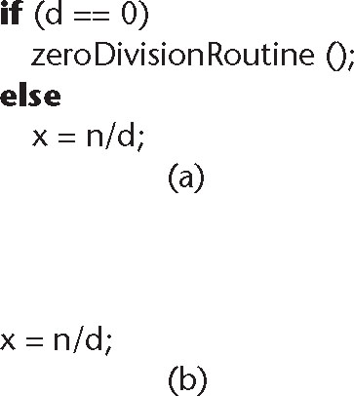
Feasibility of Testing to Code (contd)
A path can be tested only if it is present
A programmer who omits the test for d = 0 in the code probably is unaware of the possible danger
Figure 14.12

Slide 75
Feasibility of Testing to Code (contd)
Criterion “exercise all paths” is not reliable
  Products exist for which some data exercising a given path detect a fault, and other data exercising the same path do not

Slide 76
14.11 Black-Box Unit-testing Techniques
Neither exhaustive testing to specifications nor exhaustive testing to code is feasible
The art of testing:
  Select a small, manageable set of test cases to
  Maximize the chances of detecting a fault, while
  Minimizing the chances of wasting a test case
Every test case must detect a previously undetected fault

Slide 77
Black-Box Unit-testing Techniques (contd)
We need a method that will highlight as many faults as possible
  First black-box test cases (testing to specifications)
  Then glass-box methods (testing to code)

Slide 78
14.11.1 Equivalence Testing and Boundary Value Analysis
Example
  The specifications for a DBMS state that the product must handle any number of records between 1 and 16,383 (2¹⁴ – 1)
  If the system can handle 34 records and 14,870 records, then it probably will work fine for 8,252 records
If the system works for any one test case in the range (1..16,383), then it will probably work for any other test case in the range
  Range (1..16,383) constitutes an equivalence class

Slide 79
Equivalence Testing
Any one member of an equivalence class is as good a test case as any other member of the equivalence class
Range (1..16,383) defines three different equivalence classes:
  Equivalence Class 1: Fewer than 1 record
  Equivalence Class 2: Between 1 and 16,383 records
  Equivalence Class 3: More than 16,383 records

Slide 80
Boundary Value Analysis
Select test cases on or just to one side of the boundary of equivalence classes
  This greatly increases the probability of detecting a fault

Slide 81
Database Example (contd)
Test case 1: 0 records Member of equivalence class 1 and adjacent to boundary value
Test case 2: 1 record Boundary value
Test case 3: 2 records Adjacent to boundary value
Test case 4: 723 records Member of equivalence class 2

Slide 82
Database Example (contd)
Test case 5: 16,382 records Adjacent to
boundary value
Test case 6: 16,383 records Boundary value
Test case 7: 16,384 records Member of equivalence class 3 and adjacent to boundary value

Slide 83
Equivalence Testing of Output Specifications
We also need to perform equivalence testing of the output specifications
Example:
  In 2006, the minimum Social Security (OASDI) deduction from any one paycheck was $0.00, and the maximum was $5,840.40
  Test cases must include input data that should result in deductions of exactly $0.00 and exactly $5,840.40
  Also, test data that might result in deductions of less than $0.00 or more than $5,840.40

Slide 84
Overall Strategy
Equivalence classes together with boundary value analysis to test both input specifications and output specifications
  This approach generates a small set of test data with the potential of uncovering a large number of faults

Slide 85
14.11.2 Functional Testing
An alternative form of black-box testing for classical software
  We base the test data on the functionality of the code artifacts
Each item of functionality or function is identified
Test data are devised to test each (lower-level) function separately
Then, higher-level functions composed of these lower-level functions are tested

Slide 86
Functional Testing (contd)
In practice, however
  Higher-level functions are not always neatly constructed out of lower-level functions using the constructs of structured programming
  Instead, the lower-level functions are often intertwined
Also, functionality boundaries do not always coincide with code artifact boundaries
  The distinction between unit testing and integration testing becomes blurred
  This problem also can arise in the object-oriented paradigm when messages are passed between objects

Slide 87
Functional Testing (contd)
The resulting random interrelationships between code artifacts can have negative consequences for management
  Milestones and deadlines can become ill-defined
  The status of the project then becomes hard to determine

Slide 88
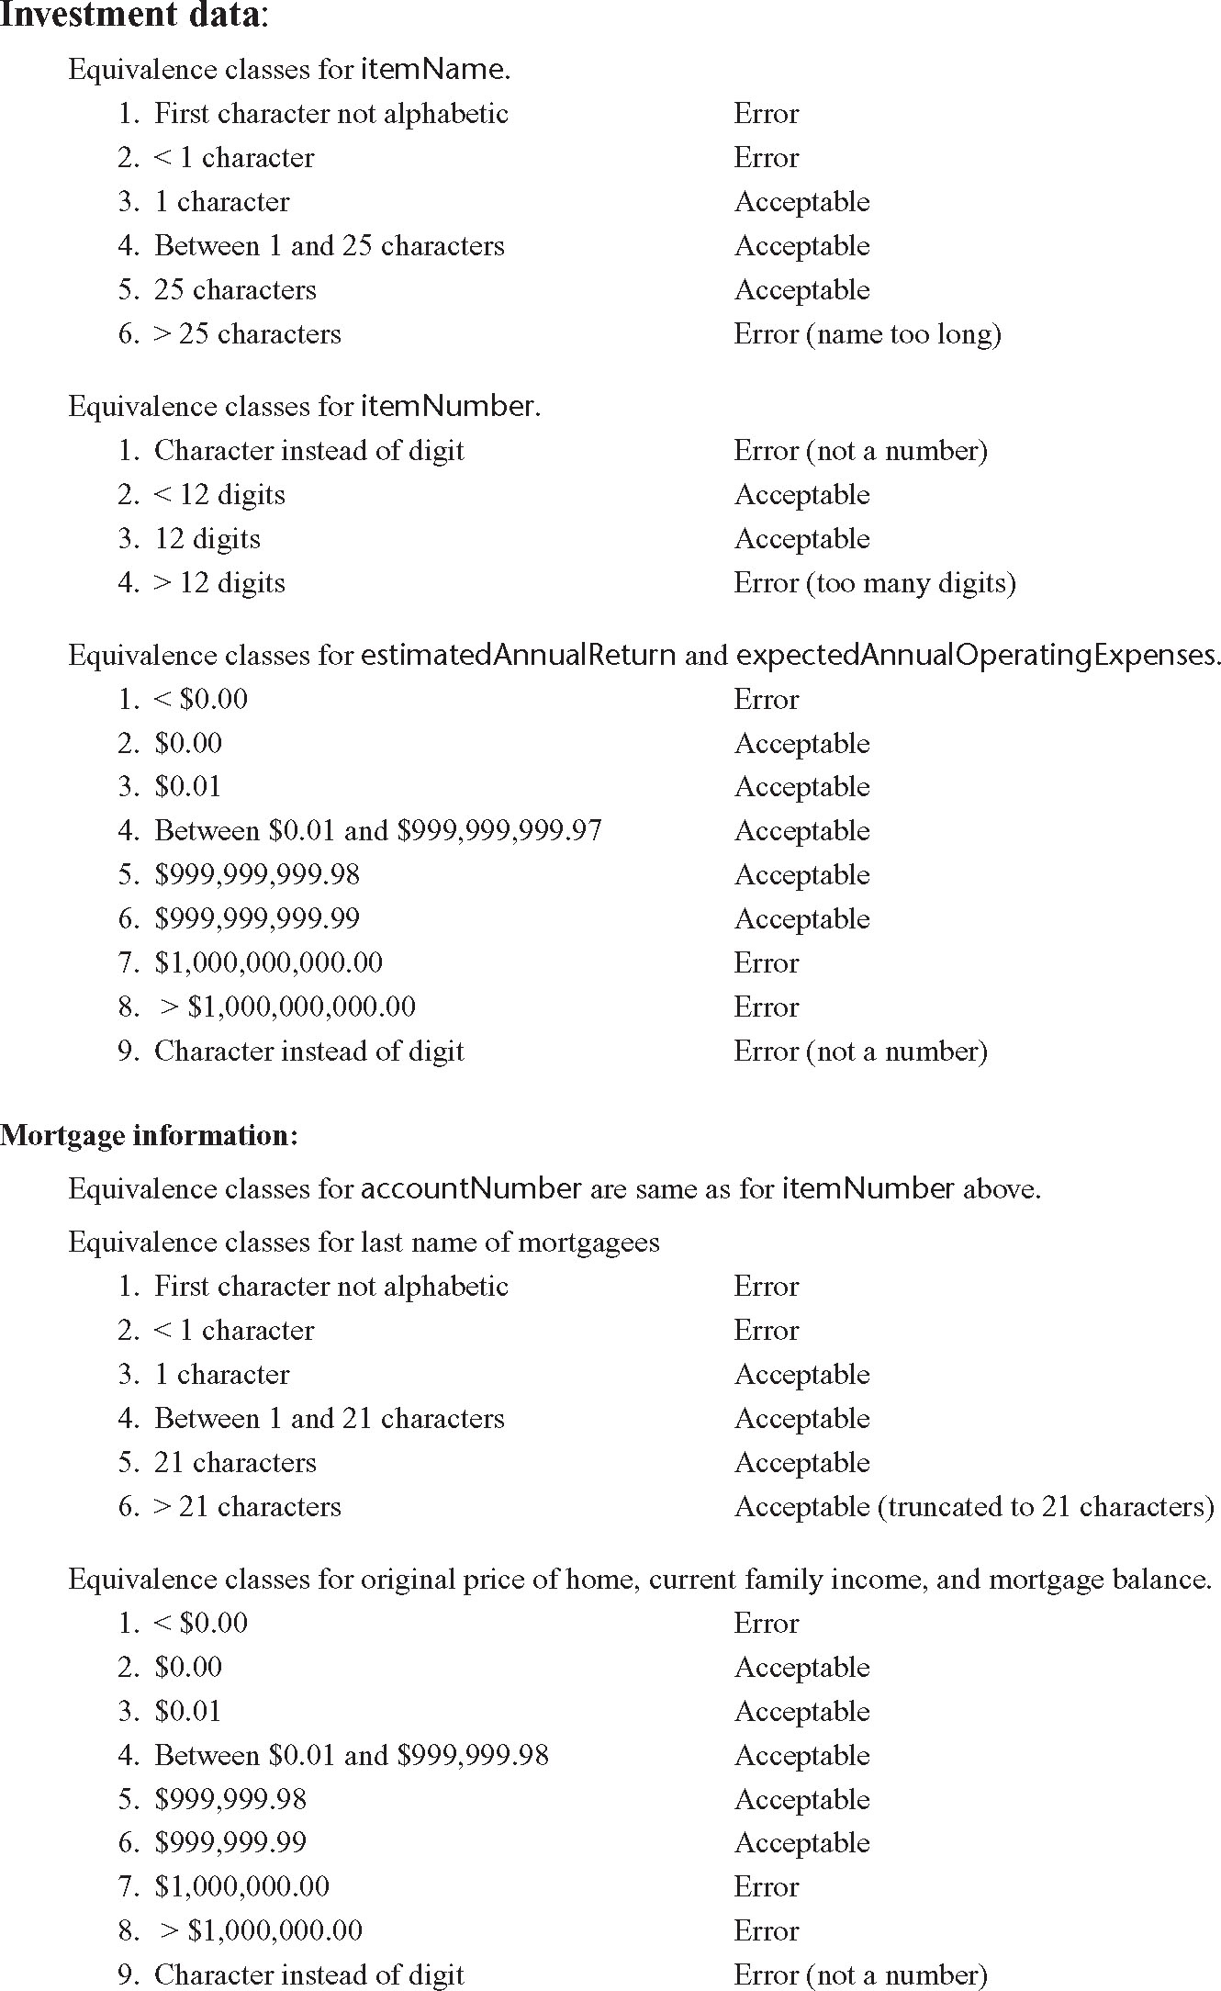
14.12 Black-Box Test Cases: The MSG Foundation Case Study
Test cases derived from equivalence classes and boundary value analysis
Figure 14.13a

Slide 89
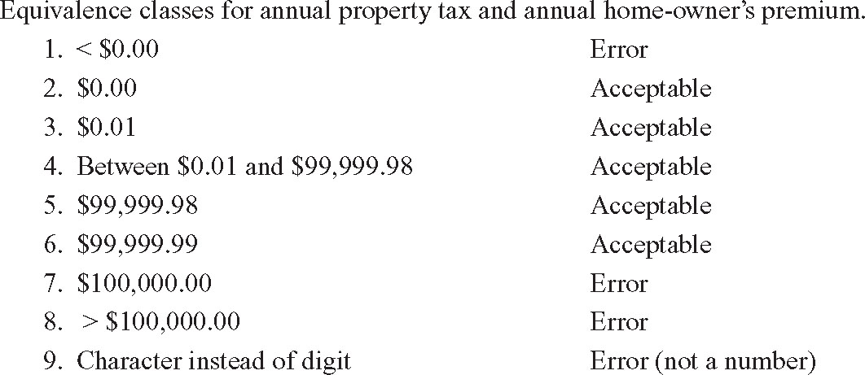
Black-Box Test Cases: MSG Foundation (contd)
Test cases derived from equivalence classes and boundary value analysis (contd)
Figure 14.13b

Slide 90
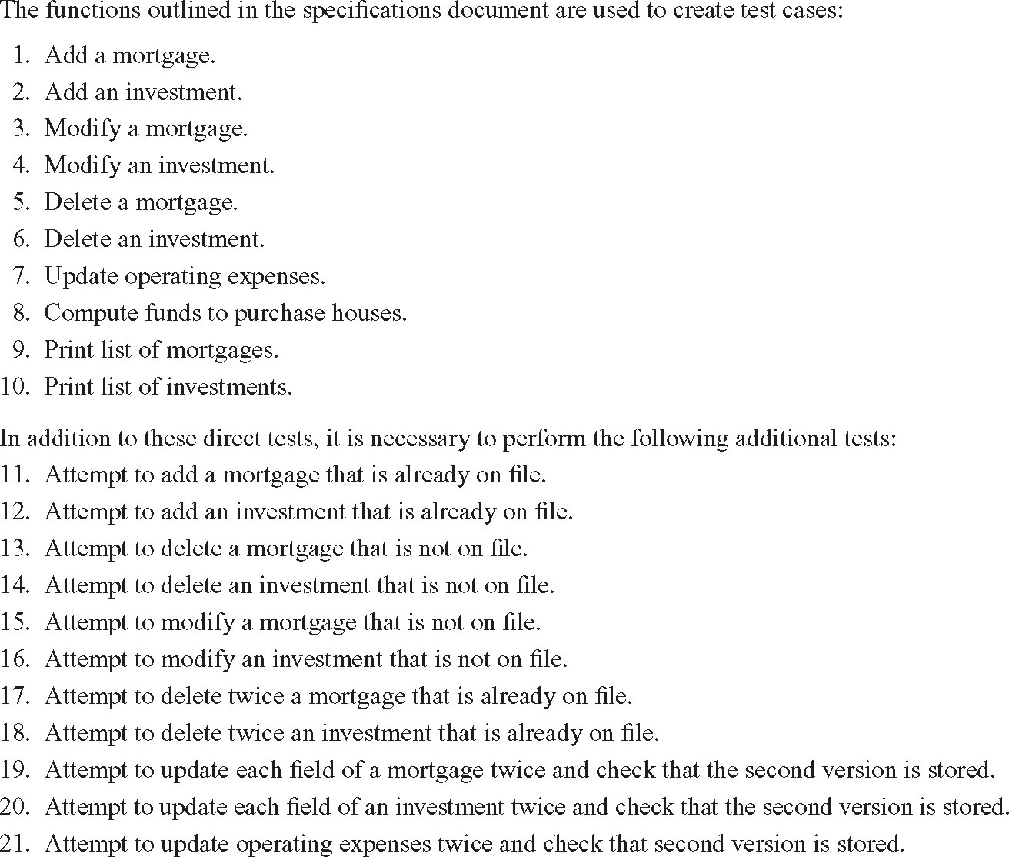
Black-Box Test Cases: MSG Foundation (contd)
Functional testing test cases
Figure 14.14

Slide 91
14.13 Glass-Box Unit-Testing Techniques
We will examine
  Statement coverage
  Branch coverage
  Path coverage
  Linear code sequences
  All-definition-use path coverage

Slide 92
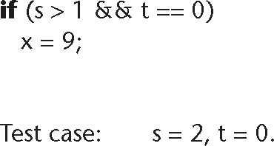
14.13.1 Structural Testing: Statement, Branch, and Path Coverage
Statement coverage:
  Running a set of test cases in which every statement is executed at least once
  A CASE tool needed to keep track
Weakness
  Branch statements
Both statements can be executed without the fault showing up
Figure 14.15

Slide 93
Structural Testing: Branch Coverage
Running a set of test cases in which every branch is executed at least once (as well as all statements)
  This solves the problem on the previous slide
  Again, a CASE tool is needed

Slide 94
Structural Testing: Path Coverage
Running a set of test cases in which every path is executed at least once (as well as all statements)
Problem:
  The number of paths may be very large
We want a weaker condition than all paths but that shows up more faults than branch coverage

Slide 95
Linear Code Sequences
Identify the set of points L from which control flow may jump, plus entry and exit points
Restrict test cases to paths that begin and end with elements of L
This uncovers many faults without testing every path

Slide 96
All-Definition-Use-Path Coverage
Each occurrence of variable, zz say, is labeled either as
  The definition of a variable
    zz = 1 or read (zz)
  or the use of variable
    y = zz + 3 or if (zz < 9) errorB ()
Identify all paths from the definition of a variable to the use of that definition
  This can be done by an automatic tool
A test case is set up for each such path

Slide 97
All-Definition-Use-Path Coverage (contd)
Disadvantage:
  Upper bound on number of paths is 2^{d}, where d is the number of branches
In practice:
  The actual number of paths is proportional to d
This is therefore a practical test case selection technique

Slide 98
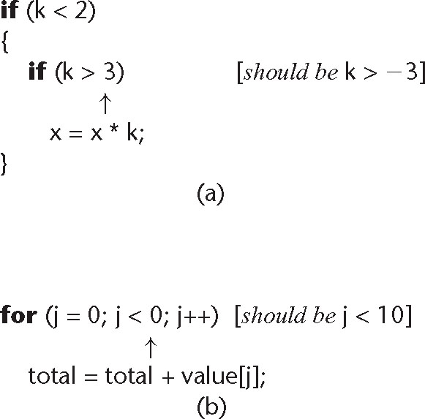
Infeasible Code
It may not be possible to test a specific statement
  We may have an infeasible path (“dead code”) in the artifact
Frequently this is evidence of a fault
Figure 14.16

Slide 99
14.13.2 Complexity Metrics
A quality assurance approach to glass-box testing
Artifact m1 is more “complex” than artifact m2
  Intuitively, m1 is more likely to have faults than artifact m2
If the complexity is unreasonably high, redesign and then reimplement that code artifact
  This is cheaper and faster than trying to debug a fault-prone code artifact

Slide 100
Lines of Code
The simplest measure of complexity
  Underlying assumption: There is a constant probability p that a line of code contains a fault
Example
  The tester believes each line of code has a 2% chance of containing a fault.
  If the artifact under test is 100 lines long, then it is expected to contain 2 faults
The number of faults is indeed related to the size of the product as a whole

Slide 101
Other Measures of Complexity
Cyclomatic complexity M (McCabe)
  Essentially the number of decisions (branches) in the artifact
  Easy to compute
  A surprisingly good measure of faults (but see next slide)
In one experiment, artifacts with M > 10 were shown to have statistically more errors

Slide 102
Problem with Complexity Metrics
Complexity metrics, as especially cyclomatic complexity, have been strongly challenged on
  Theoretical grounds
  Experimental grounds, and
  Their high correlation with LOC
Essentially we are measuring lines of code, not complexity

Slide 103
Code Walkthroughs and Inspections
Code reviews lead to rapid and thorough fault detection
  Up to 95% reduction in maintenance costs

Slide 104
14.15 Comparison of Unit-Testing Techniques
Experiments comparing
  Black-box testing
  Glass-box testing
  Reviews
[Myers, 1978] 59 highly experienced programmers
  All three methods were equally effective in finding faults
  Code inspections were less cost-effective
[Hwang, 1981]
  All three methods were equally effective

Slide 105
Comparison of Unit-Testing Techniques (contd)
[Basili and Selby, 1987] 42 advanced students in two groups, 32 professional programmers
Advanced students, group 1
  No significant difference between the three methods
Advanced students, group 2
  Code reading and black-box testing were equally good
  Both outperformed glass-box testing
Professional programmers
  Code reading detected more faults
  Code reading had a faster fault detection rate

Slide 106
Comparison of Unit-Testing Techniques (contd)
Conclusion
  Code inspection is at least as successful at detecting faults as glass-box and black-box testing

Slide 107
Cleanroom
A different approach to software development
Incorporates
  An incremental process model
  Formal techniques
  Reviews

Slide 108
Cleanroom (contd)
Prototype automated documentation system for the U.S. Naval Underwater Systems Center
1820 lines of FoxBASE
  18 faults were detected by “functional verification”
  Informal proofs were used
  19 faults were detected in walkthroughs before compilation
  There were NO compilation errors
  There were NO execution-time failures

Slide 109
Cleanroom (contd)
Testing fault rate counting procedures differ:
Usual paradigms:
  Count faults after informal testing is complete (once SQA starts)
Cleanroom
  Count faults after inspections are complete (once compilation starts)

Slide 110
Report on 17 Cleanroom Products
Operating system
  350,000 LOC
  Developed in only 18 months
  By a team of 70
  The testing fault rate was only 1.0 faults per KLOC
Various products totaling 1 million LOC
  Weighted average testing fault rate: 2.3 faults per KLOC
“[R]emarkable quality achievement”

Slide 111
Potential Problems When Testing Objects
We must inspect classes and objects
We can run test cases on objects (but not on classes)

Slide 112
Potential Problems When Testing Obj. (contd)
A typical classical module:
  About 50 executable statements
  Give the input arguments, check the output arguments
A typical object:
  About 30 methods, some with only 2 or 3 statements
  A method often does not return a value to the caller — it changes state instead
  It may not be possible to check the state because of information hiding
  Example: Method determineBalance — we need to know accountBalance before, after

Slide 113
Potential Problems When Testing Obj. (contd)
We need additional methods to return values of all state variables
  They must be part of the test plan
  Conditional compilation may have to be used
An inherited method may still have to be tested (see next four slides)

Slide 114
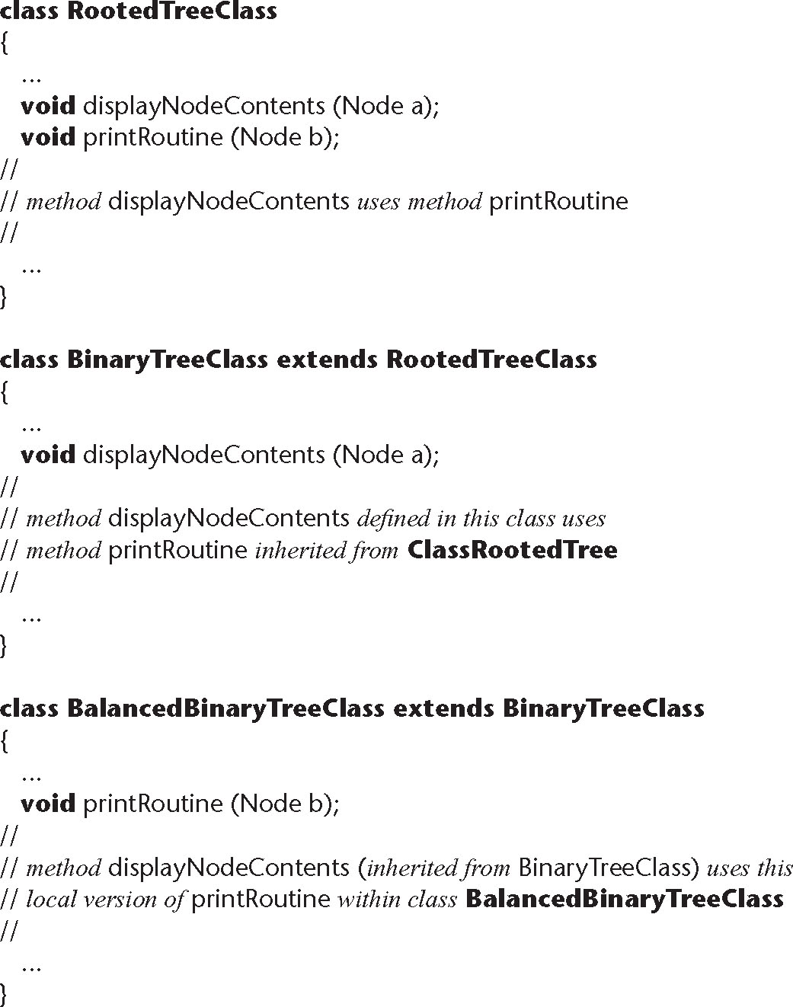
Potential Problems When Testing Obj. (contd)
Java implementation of a tree hierarchy
Figure 14.17

Slide 115
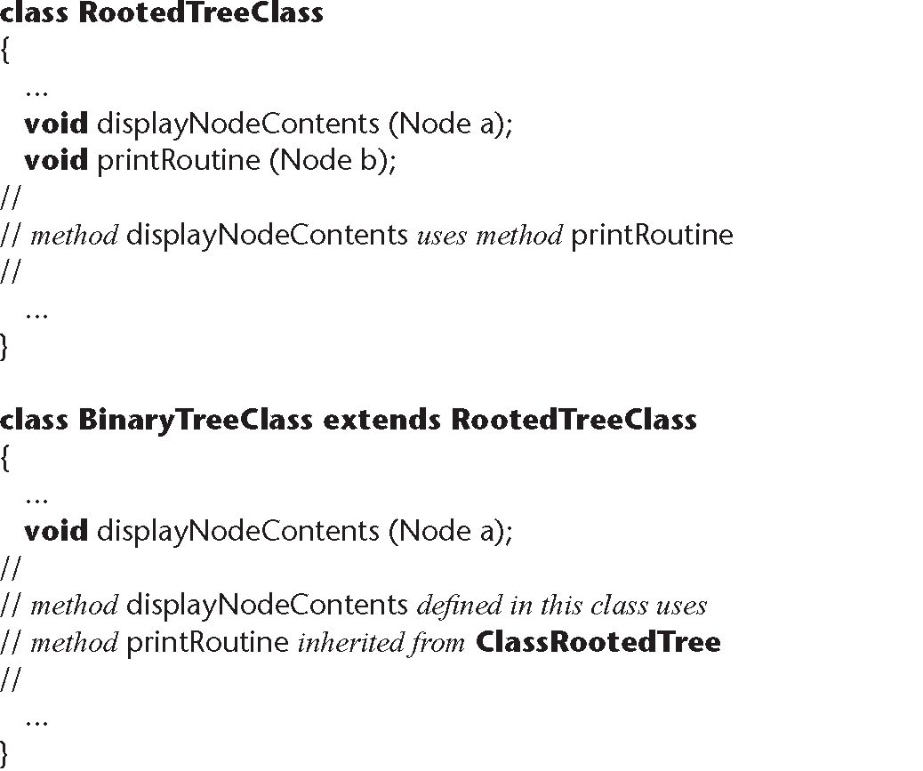
Potential Problems When Testing Obj. (contd)
Top half
When displayNodeContents is invoked in BinaryTreeClass, it uses RootedTreeClass.printRoutine
Figure 14.17
(top half)

Slide 116
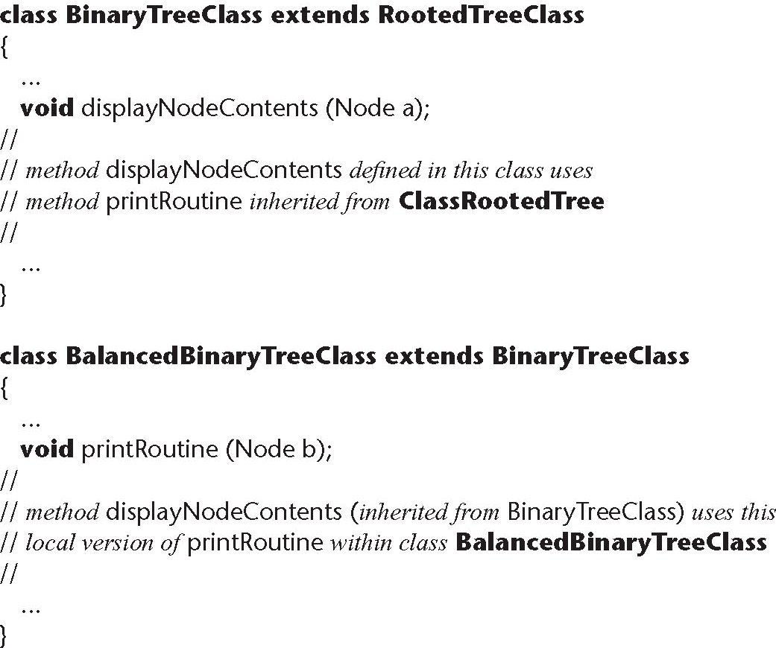
Potential Problems When Testing Obj. (contd)
Bottom half
When displayNodeContents is invoked in BalancedBinaryTreeClass, it uses BalancedBinaryTreeClass.printRoutine
Figure 14.17
(bottom half)

Slide 117
Potential Problems When Testing Obj. (contd)
Bad news
  BinaryTreeClass.displayNodeContents must be retested from scratch when reused in BalancedBinaryTreeClass
  It invokes a different version of printRoutine
Worse news
  For theoretical reasons, we need to test using totally different test cases

Slide 118
Potential Problems When Testing Obj. (contd)
Making state variables visible
  Minor issue
Retesting before reuse
  Arises only when methods interact
  We can determine when this retesting is needed
These are not reasons to abandon the object-oriented paradigm

Slide 119
14.18 Management Aspects of Unit Testing
We need to know when to stop testing
A number of different techniques can be used
  Cost–benefit analysis
  Risk analysis
  Statistical techniques

Slide 120
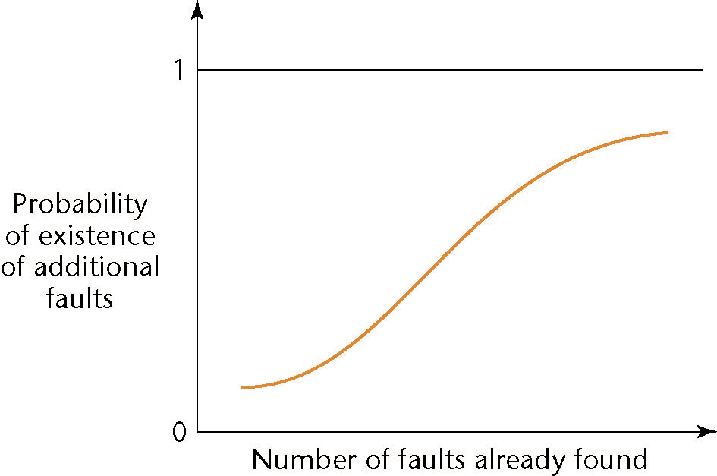
14.19 When to Rewrite Rather Than Debug
When a code artifact has too many faults
  It is cheaper to redesign, then recode
The risk and cost of further faults are too great
Figure 14.18

Slide 121
Fault Distribution in Modules Is Not Uniform
[Myers, 1979]
  47% of the faults in OS/370 were in only 4% of the modules
[Endres, 1975]
  512 faults in 202 modules of DOS/VS (Release 28)
  112 of the modules had only one fault
  There were modules with 14, 15, 19 and 28 faults, respectively
  The latter three were the largest modules in the product, with over 3000 lines of DOS macro assembler language
  The module with 14 faults was relatively small, and very unstable
  A prime candidate for discarding, redesigning, recoding

Slide 122
When to Rewrite Rather Than Debug (contd)
For every artifact, management must predetermine the maximum allowed number of faults during testing
If this number is reached
  Discard
  Redesign
  Recode
The maximum number of faults allowed after delivery is ZERO

Slide 123
14.20 Integration Testing
The testing of each new code artifact when it is added to what has already been tested
Special issues can arise when testing graphical user interfaces — see next slide

Slide 124
Integration Testing of Graphical User Interfaces
GUI test cases include
  Mouse clicks, and
  Key presses
These types of test cases cannot be stored in the usual way
  We need special CASE tools
Examples:
  QAPartner
  XRunner

Slide 125
14.21 Product Testing
Product testing for COTS software
  Alpha, beta testing
Product testing for custom software
  The SQA group must ensure that the product passes the acceptance test
  Failing an acceptance test has bad consequences for the development organization

Slide 126
Product Testing for Custom Software
The SQA team must try to approximate the acceptance test
  Black box test cases for the product as a whole
  Robustness of product as a whole
    Stress testing (under peak load)
    Volume testing (e.g., can it handle large input files?)
  All constraints must be checked
  All documentation must be
    Checked for correctness
    Checked for conformity with standards
    Verified against the current version of the product

Slide 127
Product Testing for Custom Software (contd)
The product (code plus documentation) is now handed over to the client organization for acceptance testing

Slide 128
14. 22 Acceptance Testing
The client determines whether the product satisfies its specifications
Acceptance testing is performed by
  The client organization, or
  The SQA team in the presence of client representatives, or
  An independent SQA team hired by the client

Slide 129
Acceptance Testing (contd)
The four major components of acceptance testing are
  Correctness
  Robustness
  Performance
  Documentation
These are precisely what was tested by the developer during product testing

Slide 130
Acceptance Testing (contd)
The key difference between product testing and acceptance testing is
  Acceptance testing is performed on actual data
  Product testing is preformed on test data, which can never be real, by definition

Slide 131
14.23 The Test Workflow: The MSG Foundation Case Study
The C++ and Java implementations were tested against
  The black-box test cases of Figures 14.13 and 14.14, and
  The glass-box test cases of Problems 14.30 through 14.34

Slide 132
14.24 CASE Tools for Implementation
CASE tools for implementation of code artifacts were described in Chapter 5
CASE tools for integration include
  Version-control tools, configuration-control tools, and build tools
  Examples:
    rcs, sccs, PCVS, SourceSafe

Slide 133
CASE Tools for Implementation (contd)
Configuration-control tools
  Commercial
    PCVS, SourceSafe
  Open source
    CVS

Slide 134
14.24.1 CASE Tools for the Complete Software Process
A large organization needs an environment
A medium-sized organization can probably manage with a workbench
A small organization can usually manage with just tools

Slide 135
14.24.2 Integrated Development Environments
The usual meaning of “integrated”
  User interface integration
  Similar “look and feel”
  Most successful on the Macintosh
There are also other types of integration
Tool integration
  All tools communicate using the same format
  Example:
    Unix Programmer’s Workbench

Slide 136
Process Integration
The environment supports one specific process
Subset: Technique-based environment
  Formerly: “method-based environment”
  Supports a specific technique, rather than a complete process
  Environments exist for techniques like
    Structured systems analysis
    Petri nets

Slide 137
Technique-Based Environment
Usually comprises
  Graphical support for analysis, design
  A data dictionary
  Some consistency checking
  Some management support
  Support and formalization of manual processes
  Examples:
    Analyst/Designer
    Software through Pictures
    IBM Rational Rose
    Rhapsody (for Statecharts)

Slide 138
Technique-Based Environments (contd)
Advantage of a technique-based environment
  The user is forced to use one specific method, correctly
Disadvantages of a technique-based environment
  The user is forced to use one specific method, so that the method must be part of the software process of that organization

Slide 139
14.24.3 Environments for Business Application
The emphasis is on ease of use, including
  A user-friendly GUI generator,
  Standard screens for input and output, and
  A code generator
    Detailed design is the lowest level of abstraction
    The detailed design is the input to the code generator
Use of this “programming language” should lead to a rise in productivity
Example:
  Oracle Development Suite

Slide 140
14.24.4 Public Tool Infrastructure
PCTE — Portable common tool environment
  Not an environment
  An infrastructure for supporting CASE tools (similar to the way an operating system provides services for user products)
  Adopted by ECMA (European Computer Manufacturers Association)
Example implementations:
  IBM, Emeraude

Slide 141
14.24.5 Potential Problems with Environments
No one environment is ideal for all organizations
  Each has its strengths and its weaknesses
Warning 1
  Choosing the wrong environment can be worse than no environment
  Enforcing a wrong technique is counterproductive
Warning 2
  Shun CASE environments below CMM level 3
  We cannot automate a nonexistent process
  However, a CASE tool or a CASE workbench is fine

Slide 142
14.25 Metrics for the Implementation Workflow
The five basic metrics, plus
  Complexity metrics
Fault statistics are important
  Number of test cases
  Percentage of test cases that resulted in failure
  Total number of faults, by types
The fault data are incorporated into checklists for code inspections

Slide 143
14.26 Challenges of the Implementation Workflow
Management issues are paramount here
  Appropriate CASE tools
  Test case planning
  Communicating changes to all personnel
  Deciding when to stop testing

Slide 144
Challenges of the Implementation Workflow (contd)
Code reuse needs to be built into the product from the very beginning
  Reuse must be a client requirement
  The software project management plan must incorporate reuse
Implementation is technically straightforward
  The challenges are managerial in nature

Slide 145
Challenges of the Implementation Phase (contd)
Make-or-break issues include:
  Use of appropriate CASE tools
  Test planning as soon as the client has signed off the specifications
  Ensuring that changes are communicated to all relevant personnel
  Deciding when to stop testing

Slide 146
Testing Tools
http://jakarta.apache.org/cactus/getting_started.html

